Slide 1
Objects and Classes

Slide 2
OO Programming in Java
Other than primitive data types (byte, short, int, long, float, double, char, boolean), everything else in Java is of type object.
Objects we already worked with:
String: String name = new String("John Smith");
Scanner: Scanner input = new Scanner(System.in);
Random: Random generator = new Random(100);
Date: Date date = new Date();
  System.out.println(date.toString());

Slide 3
What is an Object?
An object represents an entity in the real world that can be distinctly identified. For example, student, desk, circle, button, person, course, car, employee, department, store, computer, etc…
For instance, an object might represent a particular employee in a company. Each employee object handles the processing and management of data related to that employee.
An object has a unique identity, state, and behaviors.
The state of an object consists of a set of data fields (instance variables or properties) with their current values.
The behavior of an object is defined by a set of methods defined in the class from which the object is created.
A class describes a set of similar objects.

Slide 4
What is a Class?
A class is the blueprint (template) that defines objects of the same type, a set of similar object, such as students.
The class uses methods to define the behaviors of its objects.
The class that contains the main method of a Java program represents the entire program
A class provides a special type of methods, known as constructors, which are invoked to construct (create) objects from the class.
Multiple objects can be created from the same class.

Slide 5
Constructor Methods
The contractor method creates the object in the memory with the help of the Operating System.
Constructors are invoked using the new operator when an object is created. Constructors play the role of initializing objects.
A class can have multiple versions of the constructor method, allowing the user to create the object in different ways.
The constructor method must have same name as the class name.
Constructors do not have a return type, not even void.
A constructor with no parameters is called no-arguments constructor.

Slide 6
Default Constructor
A class may be declared without constructors.
This constructor, called a default constructor, is provided automatically only if no constructors are explicitly declared in the class.

Slide 7
Writing Classes
The programs we’ve written in previous examples have used classes defined in the Java standard class library.
Now, we will begin to design programs that rely on classes that we write ourselves.
The class that contains the main method is just the starting point of a program. This is also known as the driver/test program

Slide 8
Example
A class
(the concept)
An object
(the implementation)
Bank Account
John’s Bank Account
Balance: $7,890
State
OwnerName
Balance
Deposit()
Withdraw()
CheckBalance()
Amy’s Bank Account
Balance: $298,987
Behavior
Ed’s Bank Account
Balance: $860,883
Multiple objects
from the same class

Slide 9
Class Circle Constructors
class Circle {
// The radius of this circle
double radius = 1.0;
Data field
//
Construct a circle object
Circle() {
}
Constructors
/
/
Construct a circle object
Circle(double newRadius) {
radius = newRadius;
}
// Return the area of this circle
double getArea() {
Method
return radius * radius * 3.14159;
// other methods
}
}

Slide 10
Creating Objects
To reference an object, assign the object to a reference variable.
To declare a reference variable, use the syntax:
ClassName objectRefVar;
Example:
Circle circle1, circle2; //reference variables
circle1 = new Circle(); //calls first constructor
circle2 = new Circle(25.0); //calls second constructor
OR
Circle circle1 = new Circle();
Circle circle2 = new Circle(25.0);

Slide 11
Accessing the Object
Referencing the object’s data fields:
objectRefVar.data
double radius1 = circle1.radius; //data field
Invoking the object’s method:
objectRefVar.methodName(arguments)
double area1 = mcircle1.getArea(); //class method

Slide 12
Trace Code
animation
Declare myCircle
Circle myCircle = new Circle(5.0);
Circle yourCircle = new Circle();
yourCircle.radius = 100;
myCircle
no value

Slide 13

Trace Code, cont.
animation
Circle myCircle = new Circle(5.0);
Circle yourCircle = new Circle();
yourCircle.radius = 100;
myCircle.radius = 500.0;
myCircle
no value
Create a circle

Slide 14
Trace Code, cont.
animation
Circle myCircle = new Circle(5.0);
Circle yourCircle = new Circle();
yourCircle.radius = 100;
myCircle.radius = 500.0;
myCircle
reference value
Assign object reference to myCircle

Slide 15
Trace Code, cont.
animation
Circle myCircle = new Circle(5.0);
Circle yourCircle = new Circle();
yourCircle.radius = 100;
myCircle.radius = 500.0;
myCircle
reference value
yourCircle
no value
Declare yourCircle

Slide 16

Trace Code, cont.
animation
Circle myCircle = new Circle(5.0);
Circle yourCircle = new Circle();
yourCircle.radius = 100;
myCircle.radius = 500.0;
myCircle
reference value
yourCircle
no value
Create a new Circle object

Slide 17

Trace Code, cont.
animation
Circle myCircle = new Circle(5.0);
Circle yourCircle = new Circle();
yourCircle.radius = 100;
myCircle.radius = 500.0;
myCircle
reference value
yourCircle
reference value
Assign object reference to yourCircle

Slide 18

Trace Code, cont.
animation
Circle myCircle = new Circle(5.0);
Circle yourCircle = new Circle();
yourCircle.radius = 100;
myCircle.radius = 500.0;
myCircle
reference value
yourCircle
reference value
Change radius in yourCircle

Slide 19
Trace Code, cont.
animation
Circle myCircle = new Circle(5.0);
Circle yourCircle = new Circle();
yourCircle.radius = 100;
myCircle.radius = 500.0;
myCircle
reference value
: Circle
radius:
500.0
Change radius in myCircle
yourCircle
reference value

Slide 20
Caution
Recall that we used
  Math.methodName(arguments)
  (e.g., Math.pow(3, 2.5))
to invoke a method in the Math class.
Can you invoke getArea() using Circle1.getArea()?
All the methods defined in the Math class are static (defined using the static keyword). However, method getArea() is non-static. It must be invoked from an object using this syntax:
  objectRefVar.methodName(arguments)
  (e.g., myCircle.getArea())

Slide 21
Primitive Type vs. Object Type
Primitive type
int i = 1 i
1
Object type
Circle c
c
reference
c: Circle
radius = 1
Created using: myCircle = new Circle(1.0);

Slide 22
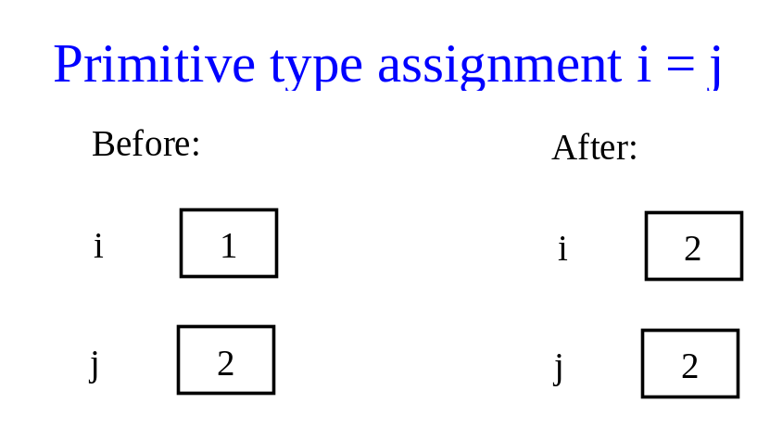
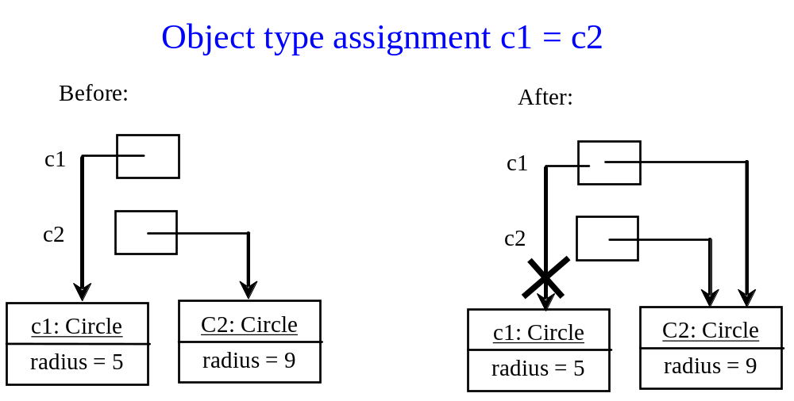
Primitive Type vs. Object Type

Slide 23
Static Variables, Constants, and Methods
Static variables are shared by all the objects of the class.
Static methods are not tied to a specific object, applied to all objects of the class.
Static constants (final variables) are shared by all the objects of the class.
To declare static variables, constants, and methods, use the static modifier.

Slide 24
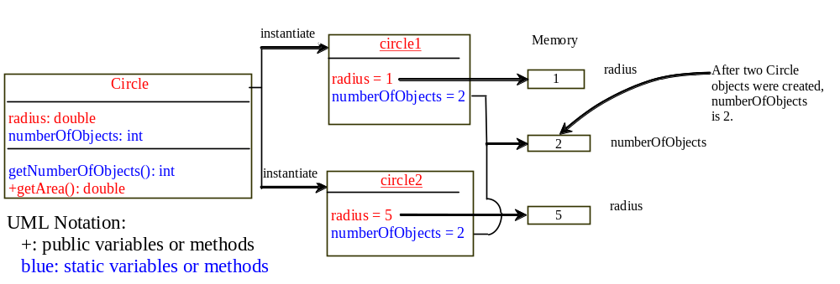
Static Variables, Constants, and Methods

Slide 25
Visibility Modifiers
By default (no qualifier), the class variable or method can be accessed by any class in the same package, but not other packages.
Public:
The class, data, or method is visible to any class in any package.
Private:
The data or methods can be accessed only by the declaring class.
The get and set methods are used to read and modify private variables.

Slide 26


Visibility Modifiers Example - 1
Package P1
Class C1
Class C2

Slide 27
Visibility Modifiers Example - 2
Package P1
Class C1
Class C2
Package P2
Class C3

Slide 28
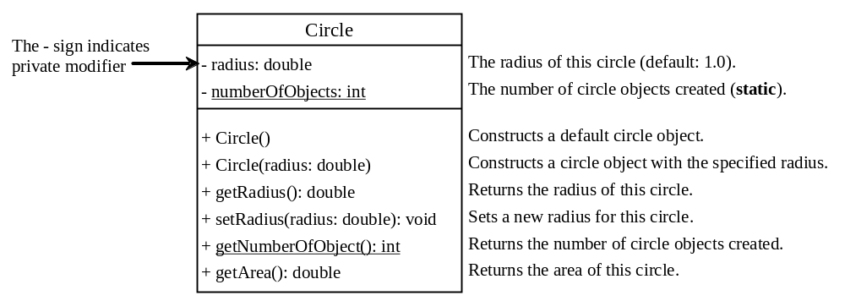
Data Field Encapsulation
Encapsulation is the idea of hiding the class internal details that are not required by clients/users of the class.
Why? To protect data and to make classes easy to maintain and update.
How? Always use private variables!

Slide 29
Visibility Modifiers - Comments - 1
Class members (variables or methods) that are declared with public visibility can be referenced/accessed anywhere in the program.
Class members that are declared with private visibility can be referenced/accessed only within that class.
Class members declared without a visibility modifier have default visibility and can be referenced/accessed by any class in the same package.
Public variables violate encapsulation because they allow class clients to “reach in” and modify the values directly. Therefore instance variables should not be declared with public visibility.

Slide 30
Visibility Modifiers - Comments - 2
Methods that provide the object's services must be declared with public visibility so that they can be invoked by clients (users of the object).
Public methods are also called service methods.
A method created simply to assist a service method is called a support method.
Since a support method is not intended to be called by a client, it should be declared with private visibility.

Slide 31
Example - 1
public class CircleWithPrivateDataFields
{
private double radius = 1;
private static int numberOfObjects = 0;
public CircleWithPrivateDataFields() { numberOfObjects++; }
public CircleWithPrivateDataFields(double newRadius) {
radius = newRadius;
numberOfObjects++;
}
public double getRadius() { return radius; }
public void setRadius(double newRadius) {
radius = (newRadius >= 0) ? newRadius : 0; //no negative radius
}
public static int getNumberOfObjects() {return numberOfObjects; }
public double getArea() {return radius*radius*Math.PI; }
}

Slide 32
public class TestCircleWithPrivateDataFields {
public static void main(String[] args) { // Main method
// Create a Circle with radius 10.0
CircleWithPrivateDataFields myCircle =
new CircleWithPrivateDataFields(10.0);
System.out.println("The area of the circle of radius "
+ myCircle.getRadius() + " is " + myCircle.getArea());
// Increase myCircle's radius by 10%
myCircle.setRadius(myCircle.getRadius() * 1.1);
System.out.println("The area of the circle of radius "
+ myCircle.getRadius() + " is " + myCircle.getArea());
}
}
Note: variable radius cannot be directly accessed.
Only through the class methods!
Output:
The area of the circle of radius 10.0 is 314.1592653589793
The area of the circle of radius 11.0 is 380.132711084365

Slide 33
End of Slides

